Slide 1
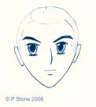
GRAPHIC NOVELS
FOR YEAR 8 NAEP
SUPER HERO
SUPER HERO
MANGA
ANIME

Slide 2
What is A Graphic Novel?
There are many debates about the exact definition. What is USUALLY agreed on is this:
A graphic novel is a sequential, comic-style narrative in book form.
A graphic novel is a medium not a genre (a graphic memoir is a graphic novel; a graphic history is a graphic novel|)

Slide 3
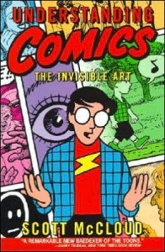
Graphic Novel" a novel in comic-strip format, it is a format, not a genre. Graphic novels can be fiction, non-fiction, history, fantasy, or anything in-between. Graphic novels are similar to comic books because they use sequential art to tell a story. Unlike comic books, graphic novels are generally stand-alone stories with more complex plots. Collections of short stories that have been previously published as individual comic books are also considered graphic novels.

Slide 4
HISTORICAL CONTEXT
The Adventures of Obadiah Oldbuck is the oldest recognized American example of comics . It originated as the 1828 publication Histoire de M. Vieux Bois by Swiss caricaturist Rodolphe Töpffer, and was first published in English translation in 1841 by London's Tilt & Bogue, which used an 1833 Paris pirate edition.
The first American edition was published in 1842 by Wilson & Company in New York City using the original printing plates from the 1841 edition. Another early predecessor is Journey to the Gold Diggins by Jeremiah Saddlebags by brothers J. A. D. and D. F. Read, inspired by The Adventures of Obadiah Oldbuck.^{[10]} In 1894 Caran d'Ache broached the idea of a "drawn novel" in a letter to the newspaper Le Figaro and started work on a 360-page wordless book (never published).
In the United States there is a long tradition of reissuing previously published comic strips in book form. In 1897 the Hearst Syndicate published such a collection of The Yellow Kid by Richard Outcault and it quickly became a best seller.
1920s saw a revival of the medieval woodcut tradition, with Belgian Frans Masereel cited as "the undisputed king" of this revival.^{[13]} His works include Passionate Journey (1926).^{[14]} American Lynd Ward also worked in this tradition, publishing Gods' Man, in 1929 and going on to publish more during the 1930s.^{[citation needed][15]}
1940s saw the launching of Classics Illustrated, a comic-book series that primarily adapted notable, public domain novels into standalone comic books for young readers. In 1947 Fawcett Comics published Comics Novel #1: "Anarcho, Dictator of Death", a 52-page comic dedicated to one story.^{[16]}

Slide 5
HISTORICAL CONTEXT
1960s, American comic book creators were becoming more adventurous with the form. Gil Kane and Archie Goodwin self-published a 40-page, magazine-format comics novel, His Name is... Savage (Adventure House Press) in 1968—the same year Marvel Comics published two issues of The Spectacular Spider-Man in a similar format. Columnist and comic-book writer Steven Grant also argues that Stan Lee and Steve Ditko's Doctor Strange story in Strange Tales #130–146, although published serially from 1965–1966, is "the first American graphic novel".^{[20]} (Similarly, critic Jason Sacks referred to the 13-issue "Panther's Rage" — comics' first-known titled, self-contained, multi-issue story arc — that ran from 1973 to 1975 in the Black Panther series in Marvel's Jungle Action as "Marvel's first graphic novel".
1970S, the term "graphic novel" appeared in print to describe three separate works. Bloodstar by Richard Corben (adapted from a story by Robert E. Howard) used the term to define itself on its dust jacket and introduction. George Metzger's Beyond Time and Again, serialized in underground comics from 1967 to 1972, was subtitled "A Graphic Novel" on the inside title page when collected as a 48-page, black-and-White, hardcover book published by Kyle & Wheary.

Slide 6
HISTORICAL CONTEXT
Another early graphic novel, though it carried no self-description, was The Silver Surfer (Simon & Schuster/Fireside Books, August 1978), by Marvel Comics' Stan Lee and Jack Kirby. Significantly, this was published by a traditional book publisher and distributed through bookstores, as was cartoonist Jules Feiffer's Tantrum (Alfred A. Knopf, 1979)^{[27]} described on its dustjacket as a "novel-in-pictures".[
Following this, Marvel from 1982 to 1988 published the Marvel Graphic Novel line of 10"x7" trade paperbacks—although numbering them like comic books, from #1 (Jim Starlin's The Death of Captain Marvel) to #35 (Dennis O'Neil, Mike Kaluta, and Russ Heath's Hitler's Astrologer, starring the radio and pulp fiction character the Shadow, and released in hardcover). Marvel commissioned original graphic novels from such creators as John Byrne, J. M. DeMatteis, Steve Gerber, graphic-novel pioneer McGregor, Frank Miller, Bill Sienkiewicz, Walt Simonson, Charles Vess, and Bernie Wrightson. While most of these starred Marvel superheroes, others, such as Rick Veitch's Heartburst featured original SF/fantasy characters; others still, such as John J. Muth's Dracula, featured adaptations of literary stories or characters; and one, Sam Glanzman's A Sailor's Story, was a true-life, World War II naval tale.
Cartoonist Art Spiegelman's Pulitzer Prize-winning Maus (1986), helped establish both the term and the concept of graphic novels in the minds of the mainstream public.^{[32]} Two DC Comics book reprints of self-contained miniseries did likewise, though they were not originally published as graphic novels: Batman: The Dark Knight Returns (1986), a collection of Frank Miller's four-part comic-book series featuring an older Batman faced with the problems of a dystopian future; and Watchmen (1986-1987), a collection of Alan Moore and Dave Gibbons' 12-issue limited series in which Moore notes he "set out to explore, amongst other things, the dynamics of power in a post-Hiroshima world".^{[37]} These works and others were reviewed in newspapers and magazines, leading to increased coverage.^{[38]} Sales of graphic novels increased, with Batman: The Dark Knight Returns, for example, lasting 40 weeks on a UK best-seller list.^{[39]}

Slide 7
TYPES OF GRAPHIC NOVELS
Like traditional novels there are endless ways to categorize different graphic novels. There are as many genres and sub-genres as in traditional fiction and non-fiction. The following are only a few of the most predominant categories.
Manga: The Japanese word for "comic" but in the US is used to descript Japanese style comics. Manga is read from top to bottom and right to left as this is the traditional Japanese reading pattern. Though, technically Manga refers to Japanese comics, many think Manga refers to a style rather than the country of origin.
Titles: Death Note, Full Metal Alchemist
Superhero Story: Superhero graphic novels have taken the most popular form of comics and turned what were once brief episodic adventures into epic sagas. Superhero comics are dominated by a few mainstream publishers Marvel, DC, and Darkhorse.
Titles: Batman: Dark Knight Returns, League of Extraordinary Gentlemen, Astrocity.
Personal Narratives ("Perzines"): are autobiographical stories written from the author's personal experiences, opinions, and observations.
Titles: Fun Home, Blankets, Lucky, The Quitter.
Non-fiction: are similar to perzine's in that they are written from the author's personal experience, but the author is generally using their own experience to touch upon a greater social issue.

Slide 8
GRAPHIC NOVEL CONVENTIONS
PARTS OF THE PAGE
  Panels
  Frames
  Gutter
  Speech bubbles
  Captions
  Sound Effects
Transitions
Perspective
Notes:
Understanding the conventions of a graphic novel helps both the student and teacher access the text and enjoy the story. Looking for conventions helps students hone their critical thinking skills and puts them into a learning relationship with the text they are reading.

Slide 9
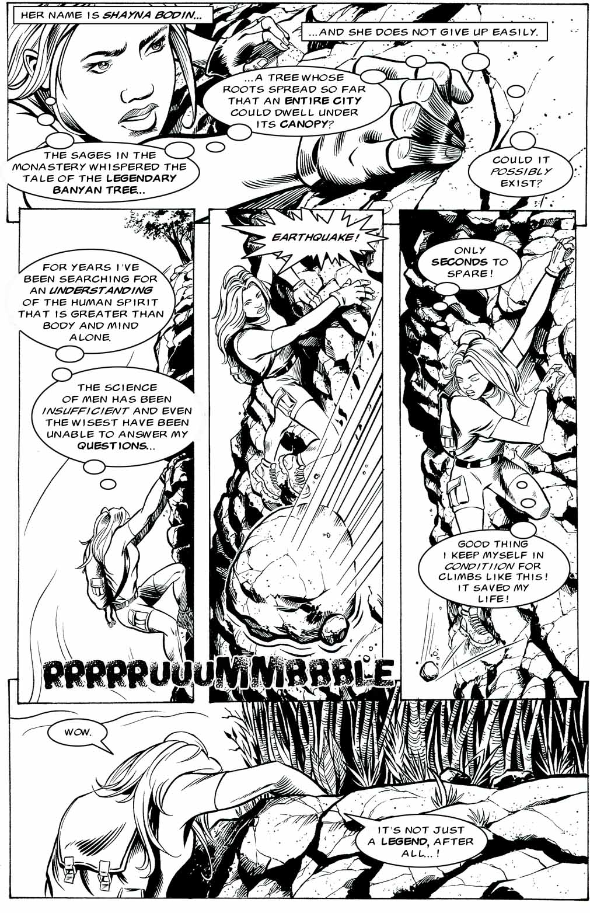
Caption
Panel
Gutter
Thought Bubble
Scream Bubble
Frame
Sound Effect
Dialogue Bubble

Slide 10
Speech and Thought Bubbles
Notes:
Different types of speech bubbles (what does each indicate?) 1. thinking 2. explosive idea/anger 3. whispering

Slide 11
GRAPHIC NOVEL
CONVENTIONS
TRANSITIONS
    Slow down an emotional moment
    Show an action sequence
    Use juxtaposition to create meaning
PERSPECTIVE
    Same vocabulary as film and photography
      Close-up, medium-shot, long-shot
      Tilt-up, tilt-down
      Panning and tracking

Slide 12
Transitions
Panel to panel transitions are relationships described in
Scott McCloud's Understanding Comics:
He defines six transitions from one panel to the next:
Moment-to-moment
2. Action-to-action
3. Subject-to-subject
4. Scene-to-scene
5. Aspect-to-aspect
6. Non-sequitur
(http://www.comixpedia.org/index.php?title=Panel-to-panel_transitions)

Slide 13
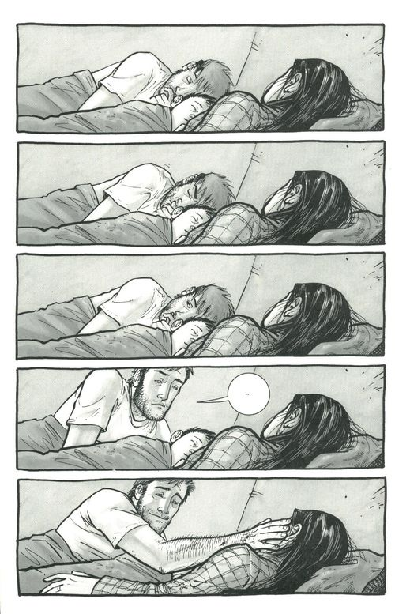
The Walking Dead
Moment-to-moment:
Relatively little change takes place between the two panels.
In writing, this is when an important moment is “slowed down”.

Slide 14
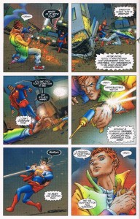
Star Superman
Action-to-action:
The actions of a single subject are shown.
In writing, this is when shorter paragraphs of descriptive action and dialogue is used.

Slide 15
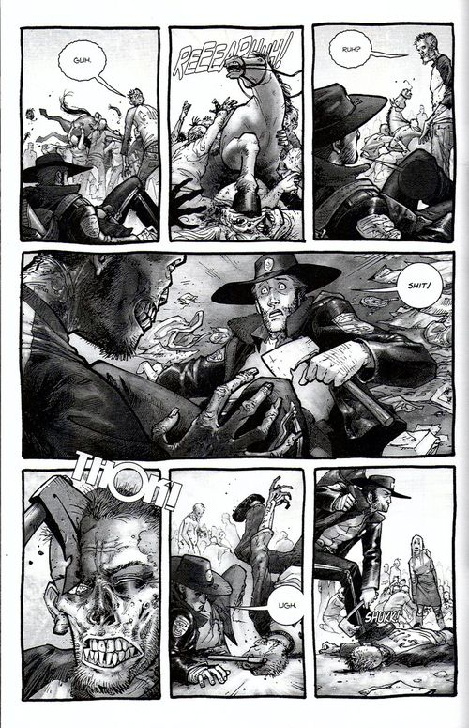
The Walking Dead
Subject-to-subject:
Transitions between different subjects in the same scene.
This is common, especially in conversations.

Slide 16
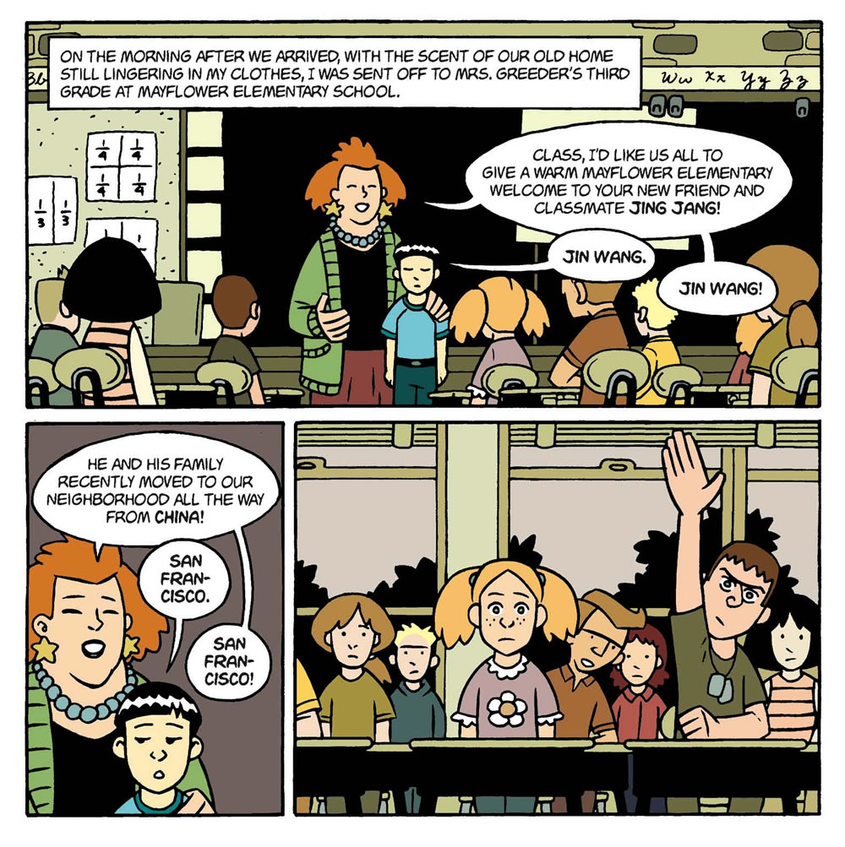
American Born Chinese

Slide 17
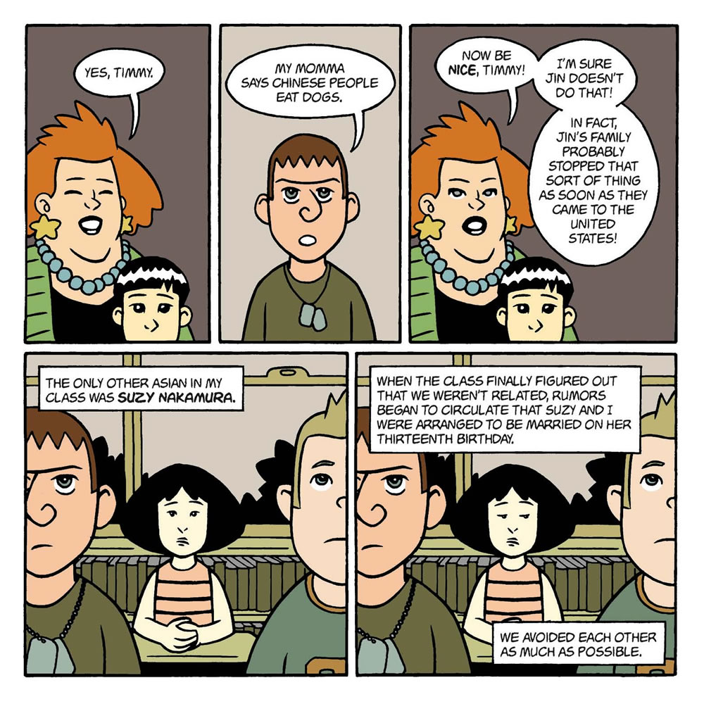
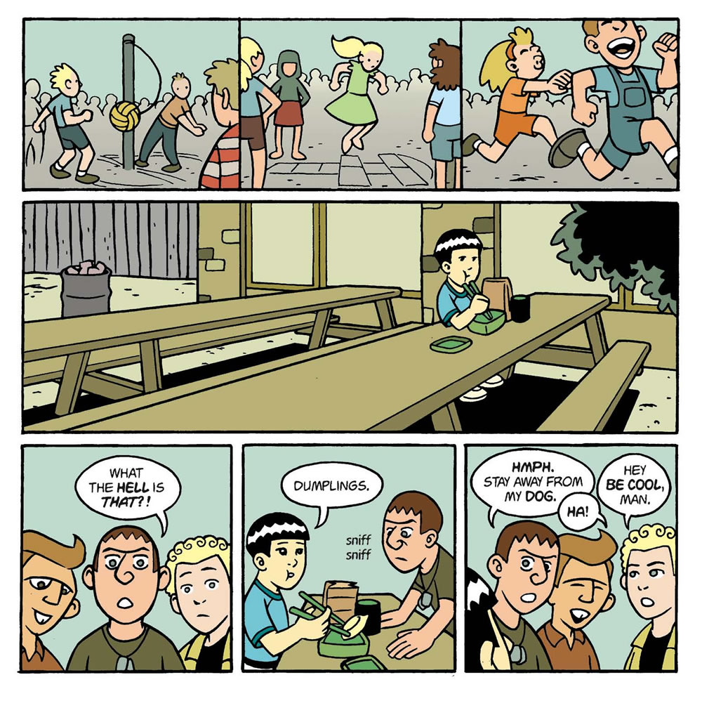

Slide 18
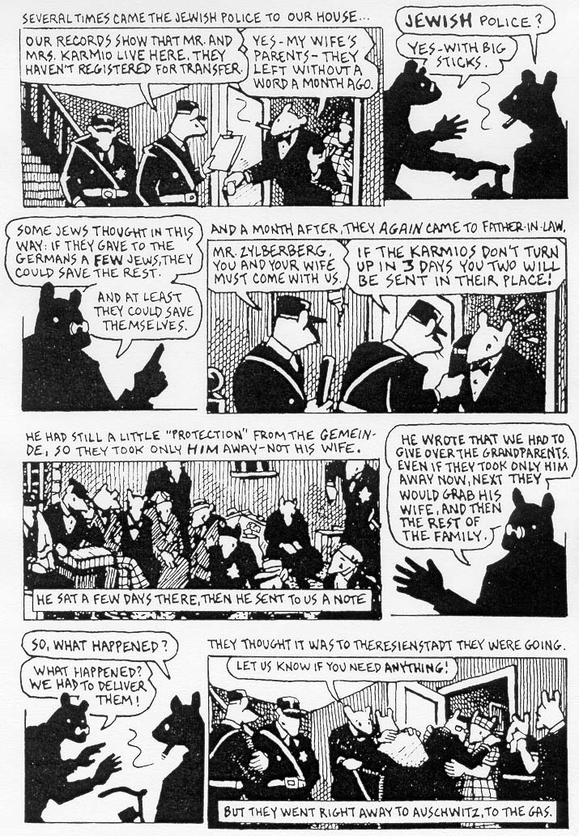
MAUS
Scene-to-scene:
“Transports us across significant distances of time and space.“
In writing, this can be a flashback or a switch of perspective, or a new paragraph or chapter.

Slide 19
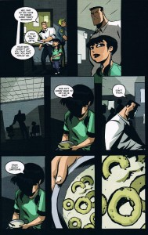
Who Killed Retro Girl?
Aspect-to Aspect:
“Bypasses time for the most part and sets a wandering eye on different aspects of a place, idea, or mood.“
In writing, this is a creative way to describe one scene in multiple ways.

Slide 20
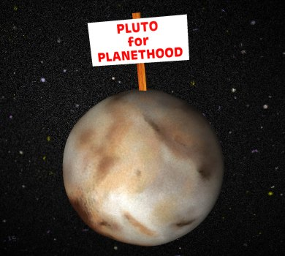
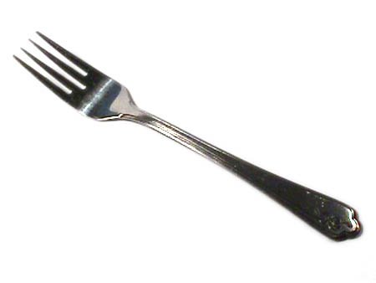
ORIGINAL
NON-SEQUITUR
Here, there is seems to be no logical connection between panels. Of course, because they are juxtaposed with one another, reader try to create meaning.
In writing, this is experimental or abstract. Often its intent is to make the reader work to make connections.

Slide 21
WHY IS READING GRAPHIC NOVELS
IMPORTANT?
Engaging
Superb texts
Can be read more quickly and re-read for deeper analysis
Visual way for students to learn literary ideas (juxtaposition, metaphor, simile, intertextuality, metafiction, “showing vs. telling”, dialogue, themes, style, etc.)
Visual way to practice reading strategies

Slide 22
WHY IS CREATING GRAPHIC PANELS
OR SHORT PANEL SEQUENCES
A GOOD IDEA?
Engaging
Students, over time, create strong texts
Can be read more quickly and re-read for deeper analysis
Visual way for students to demonstrate level of understanding of literary ideas (juxtaposition, metaphor, simile, intertextuality, metafiction, “showing vs. telling”)
Less stigma for experimenting and sharing

Slide 23
ACTIVITIES
HOW ARE YOU FEELING TODAY?
Student Instructions:
Look at the feeling panel and choose the feeling that best represents your mood.
In the panel provided, draw a picture of yourself (Close-up? Far-shot? Mid-shot?)
Remember, our expressions often masks our feelings
Include thought bubble, speech bubble and caption.
If it isn’t clear on the panel, writing the feeling word on the back of the panel.

Slide 24
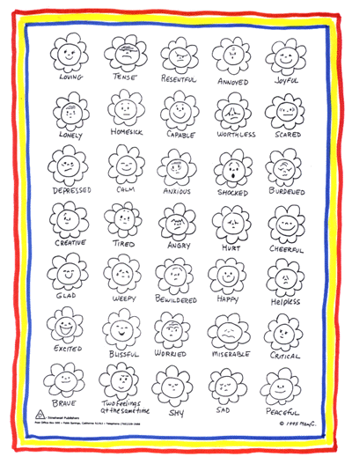
a

Slide 25
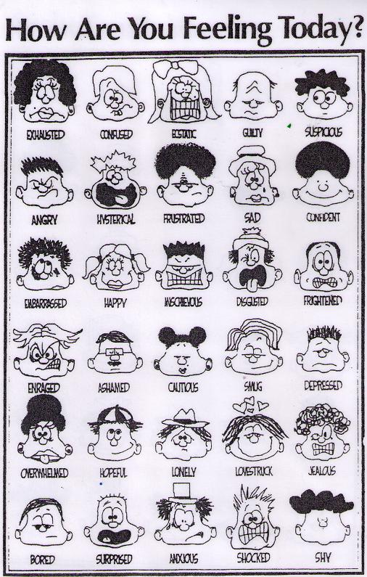

Slide 26
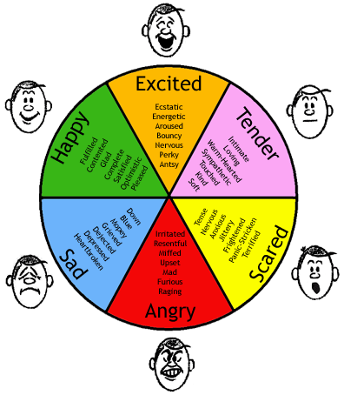

Slide 27
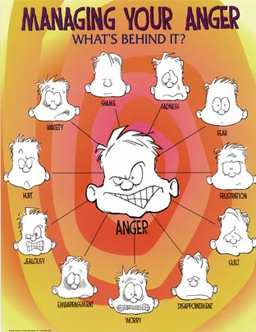

Slide 28
HOMEWORK CHECKS
Student Instructions:
Create a one page comic with 5 – 9 panels that explains how you completed your homework, what you learned and questions and obstacles you faced. Include as much content from the reading as possible.
On the reverse, scale (rate) your satisfaction with your knowledge. Write down one strategy to improve your number by one or two points.

Slide 29
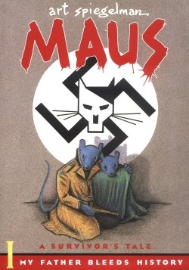

Slide 30
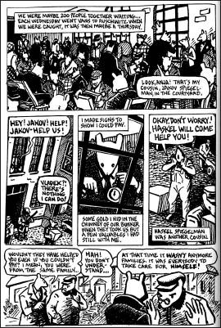

Slide 31
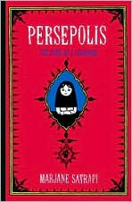

Slide 32
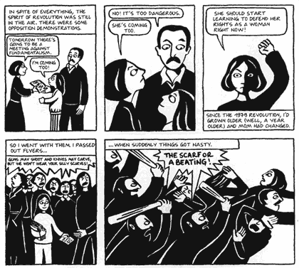

Slide 33
GRAPHIC BURSTS
Reduces stigma (it’s OK to be “bad” at drawing)
Enhances understanding of reading strategies
Retention of images is often stronger than retention of written or oral ideas
Quick to complete and quick to assess
Facilitates sharing and reflection
  Easy for students to see progression
Enhances reading, writing and media skills
Allows for bursts of success
Integrates equity: diversity of experience, recognizes and respects a variety of stories

Slide 34
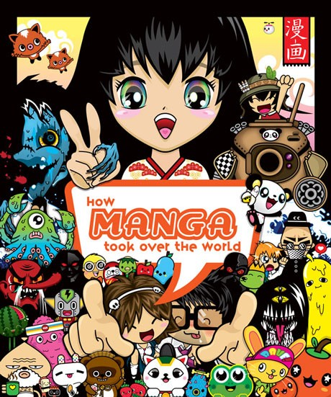
Manga
Manga=comic books
Period before WWII=beginning of modern manga
Notes:
Manga is the Japanese word for comics-literally translated it means “whimsical pictures”
Mid 1990s=came to US

Slide 35
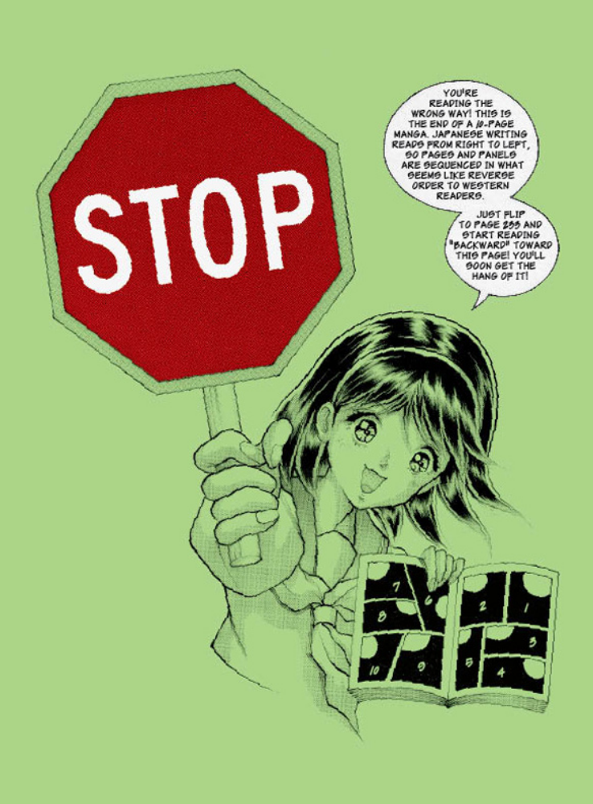
How to read a Manga Page
Unlike traditional western books, Manga is read right-to-left and “back” to “front”
Often, if you start at what looks like the front of the Manga, you will see a message like this
Notes:
Tokyopop: JAPANESE traslations are right-to-left KOREAN translations are left-to-right

Slide 36
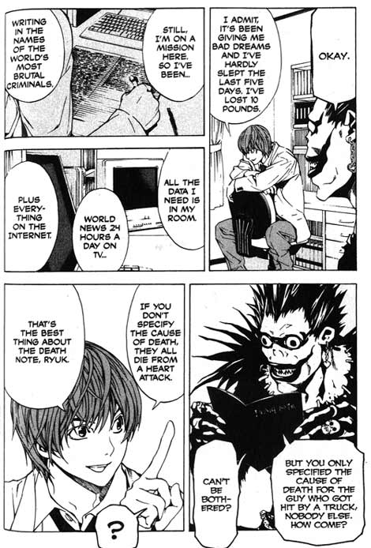
1
2
Panels are read right to left
3
4
5

Slide 37
2
3
1
4
As are dialog balloons
6
7
5
10
11
8
9

Slide 38
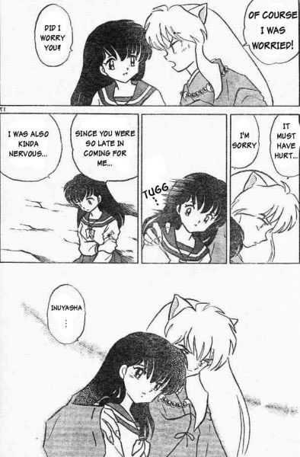
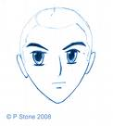
Common Manga Character Traits
Large, expressive eyes
Small noses
Tiny mouths
Notes:
Osamu Tezuka began large eye trend (1960s), influenced by Disney & Betty Boop cartoons
YOUTHFUL FEATURES=more attractive character
Also lots of eminata

Slide 39
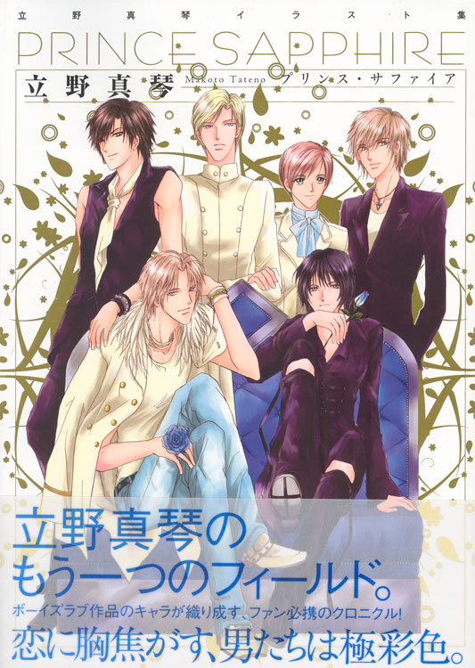
Types of Manga
Shonen: teenage boys
Shojo: teenage girls
Shonen-ai / Yaoi=boys love
Notes:
These denote the demographic group at whom the manga is marketed and usually indicates what kind of story it will be.
Shonen: more sports, contests, fighting
Shjo: more relationships, character development
Shonen-ai=FEMALE ORIENTED homoerotic/homoromantic male relationships USUALLY CREATED BY FEMALE AUTHORS

Slide 40
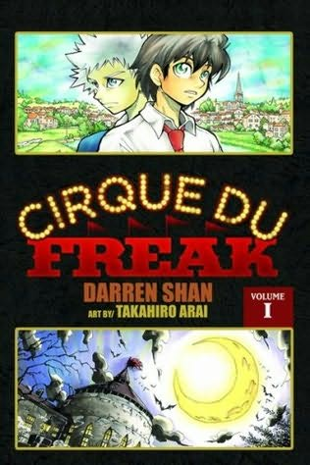
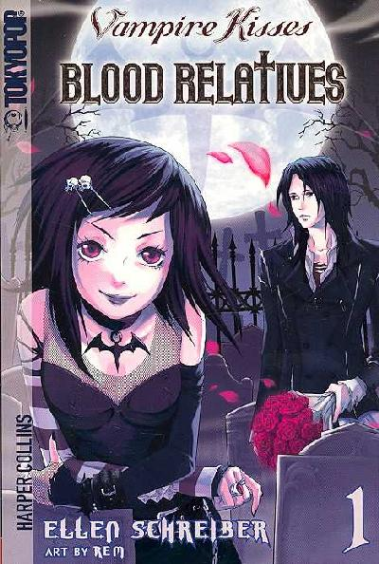
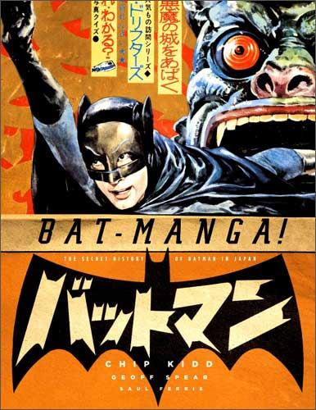
Manga Adaptations

Slide 41
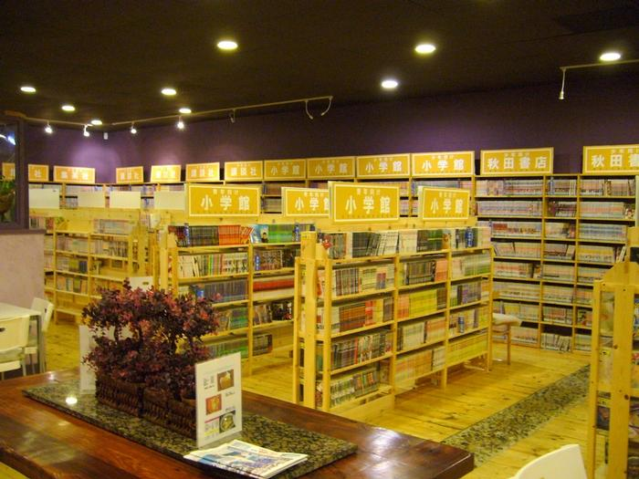
Popular & Respected
Read by everyone
Artists & writers well respected
Much anime based on manga
Notes:
Both children & adults reach high level of manga literacy in Japan
“Manga helps to release tension from the controlled work/school environment“ and helps teach people about the BELIEFS, VALUES AND PRACTICES of the culture

Slide 42
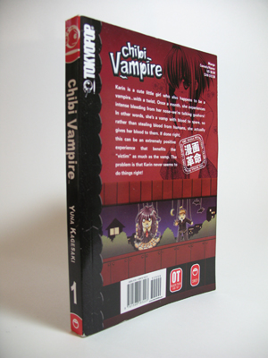
perceived as subversive=attractive!
Ratings
Notes:
Read “backwards” / cultural cues=subversive!
Viz BIG TITLES
Tokyopop BIG TITLES

Slide 43
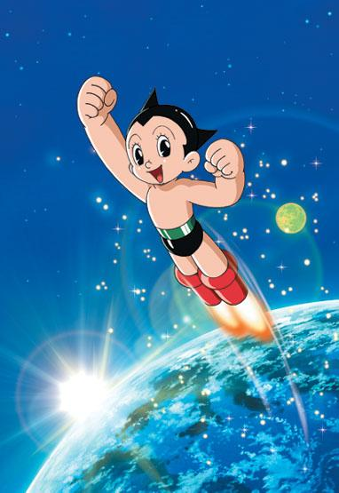
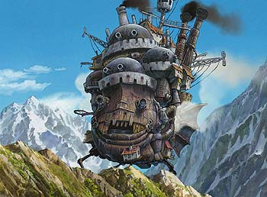
“God of Manga” Osamu Tezuka
Hayayo Miyazaki: anime & manga
Names to Know
Notes:
Tezuka: Ambassador Atom=Mighty Atom=Astro Boy, Astro Boy=mark of rise of manga of contemporary Japan
also: Adolf, Buddha
Hiyayo Miyazaki=Spirited Away (first anime to win Academy Award), Howl’s Moving Castle, Princess Mononoke, Nausicaa of the Valley of the Wind

Slide 44
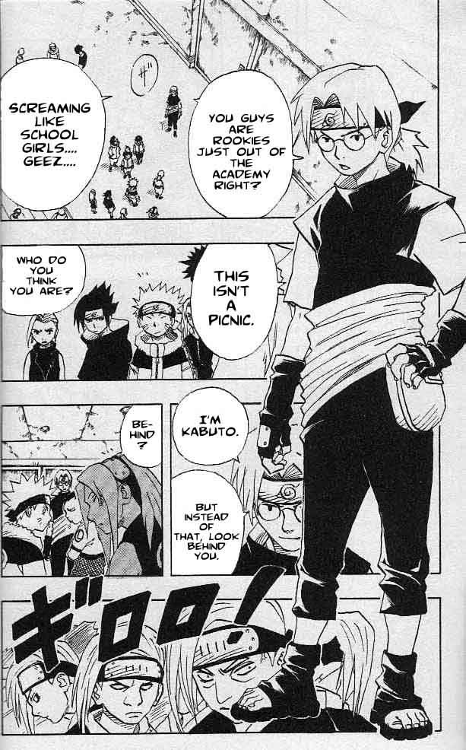
What is Manga? What is Anime?
Manga is the Japanese word for “comics”, defined here as story-length comics.
Anime is the Japanese word for “animation”.
A lot of anime series originate from popular manga, serialised in weekly form.
“Naruto” – A popular boy’s manga

Slide 45
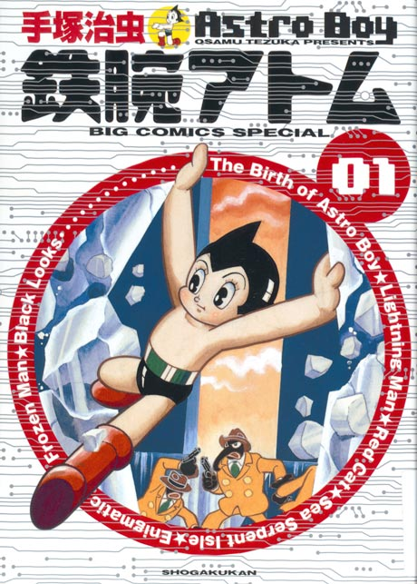
A (Brief) History of Manga
The term “manga” means “whimsical pictures”. It originated from 17th Century wood-block artists, looking for a word to describe their humourous drawings.
It evolved into its present form in post WWII-Japan. One man, Tezuka Osamu, popularised it in the 1950s.
Tezuka was the creator of “Astro Boy”, an action-adventure story intended for young children. It was a great success, which made Tezuka realise the potential the form had as a medium for story-telling.
Thus, he went on to create manga in many different genres, and for different audiences (including adults) – and “manga” as it is known today was born.

Slide 46
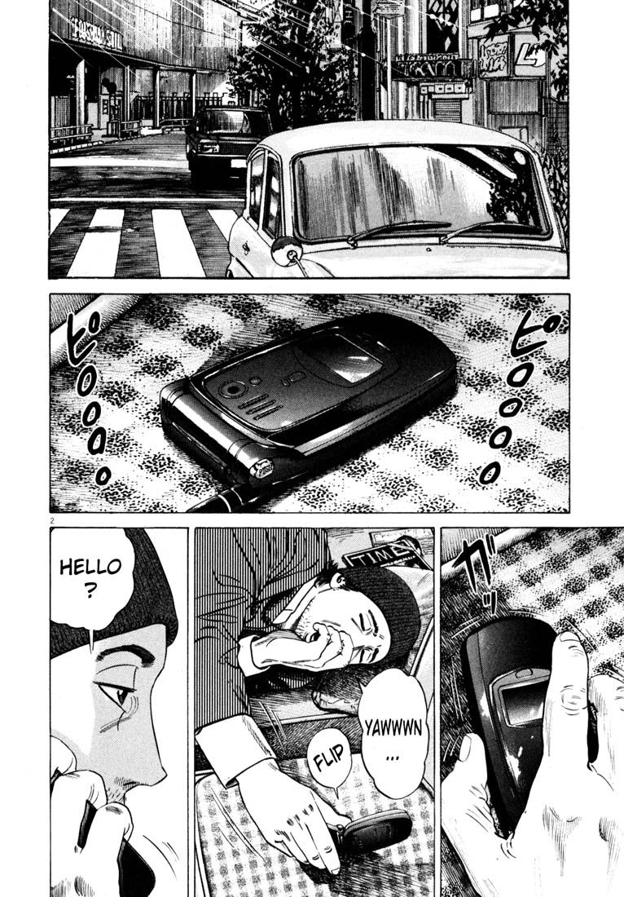
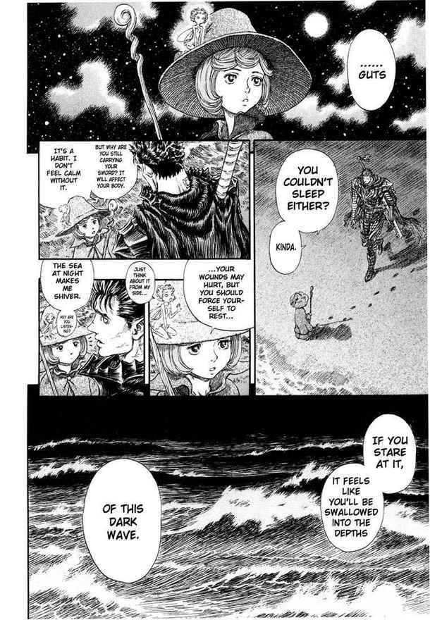
How is Manga Different From Graphic Novels?
A common stereotype of manga is the “big-eyed, small mouth” look.
In reality, only manga geared at young audiences look like that.
Manga aimed at adults have very mature art styles.
So art style is not what separates manga from graphic novels.
Left:
Homunculus (Hideo Yamamoto)
Right:
Berserk (Kentarou Muira)

Slide 47
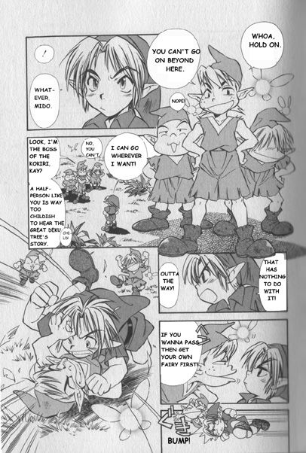
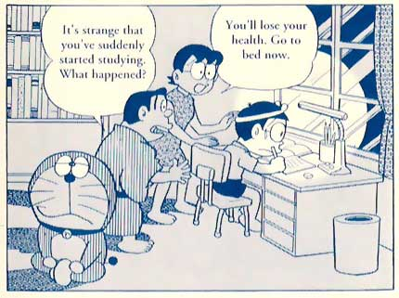
Manga Art Styles – Children
Doraemon (Fujio – F. Fujiko)
Zelda Manga (Akira Himegawa)

Slide 48
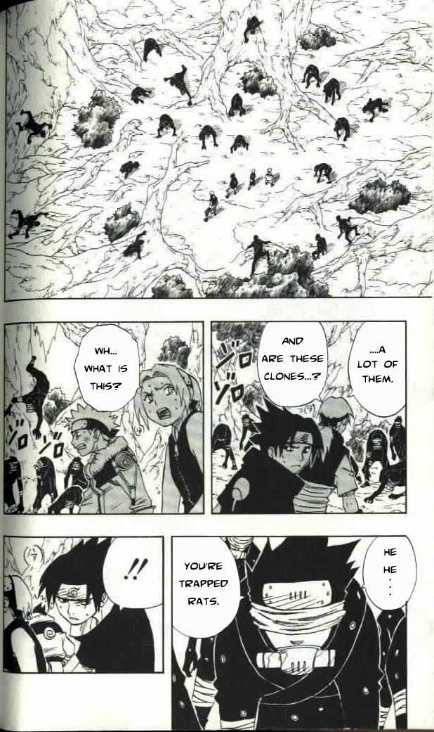
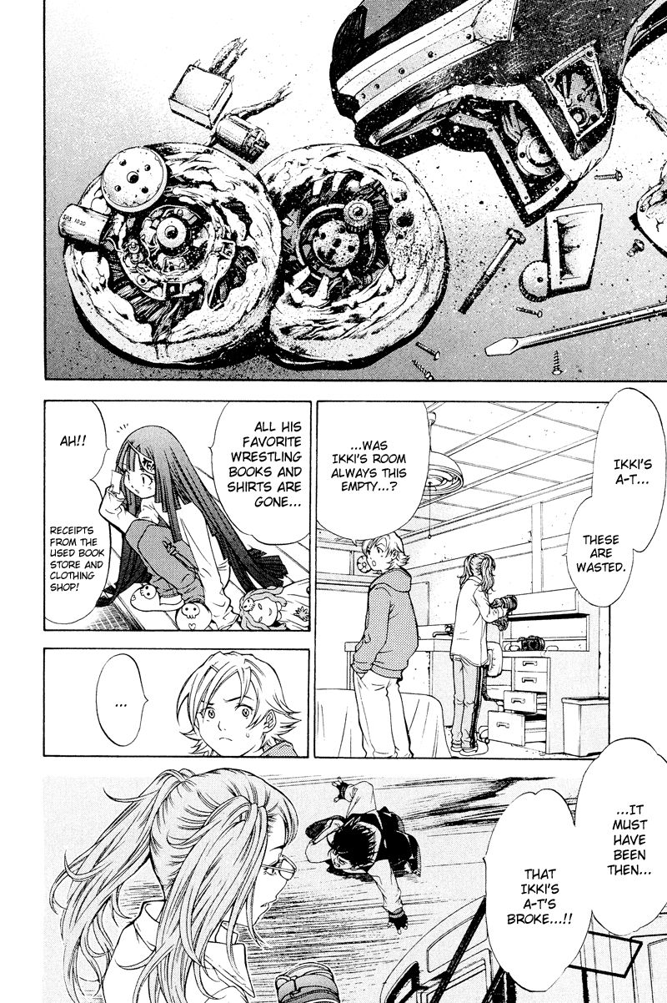
Manga Art Styles – Teenage Boys
Left:
Naruto
(Masashi
Kishimoto)
Right:
Air Gear
(Oh! Great)

Slide 49
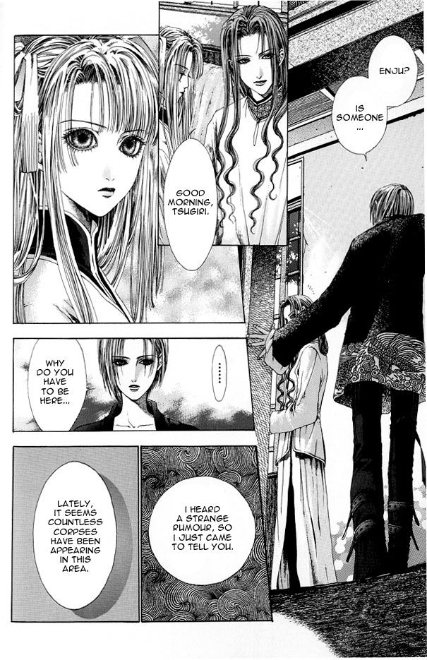
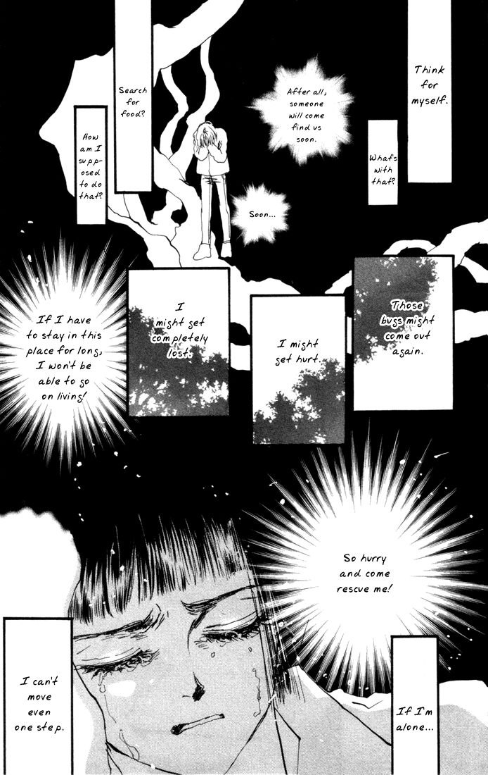
Manga Art Styles – Teenage Girls
Left:
Alichino
(Kouyu
Shurei )
Right:
7 Seeds
(Yumi
Tamura)

Slide 50
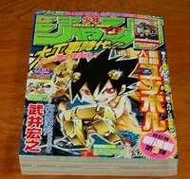
How is Manga Different From Graphic Novels? (External Factors)
History / Social Acceptability
  Manga has long been treated as serious literature in Japan. Due to its long history, adults read manga due to having grown up with it.
  40% of all printed material in Japan is manga
Publishing Format
  Most manga is serialised - published chapter by chapter in weekly or monthly chunks.
  Each published chapter is collected and sold as a single anthology magazine – depending on the subject matter and audience.
  These chapters are then collected into and sold to fans as trades. These can run into dozens of volumes.
  Due to the tight publishing schedules, manga is nearly always in black and white.

Slide 51
How is Manga Different From Graphic Novels? (External Factors)
Japan’s “Soft Power”
  Manga is part of a global promotion of Japanese culture, which includes food (sushi-trains), technology, fashion, architecture, language, music (JPop) and Japanese pop-culture exports such as anime, manga and video-gaming.
  Most popular manga series have spin-offs in other mediums, including anime series and video games. Much like how Harry Potter is used to sell everything from movie tickets to pencil cases.
  Most current western manga fans got into reading manga through watching anime and playing video games.

Slide 52
How is Manga Different From Graphic Novels? (Content)
Demographics
  There is manga for every age group and every genre under the sun.
  The most popular demographics are shounen (teenage boys) and shoujo (teenage girls). These 2 groups comprise the majority of the works exported to the West.
  Likewise, there are manga for salary men, bored housewives, right-wing militants, etc
Genres
  There are no limits as to what manga is about. It’s treated as just another artistic medium of expression
  There are manga about surgery, fire-fighting, cooking, etc – anything niche that can be served.

Slide 53
How is Manga Different From Graphic Novels? (Content)
Story-telling
  Story-telling is where manga differs dramatically from graphic novels. The Japanese have their own visual language, one that’s very particular to manga.
  There is a way to tell a story in manga form, and this method differs depending on your target audience, and the kind of story you’re telling.
  Manga is very cinematic in its style of story-telling. Panels are laid out on a page which maximises the visual impact of something.
  Thanks to manga’s long history, creators have come up with all sorts of artistic cues to express action, emotional turmoil, and everything in between.

Slide 54
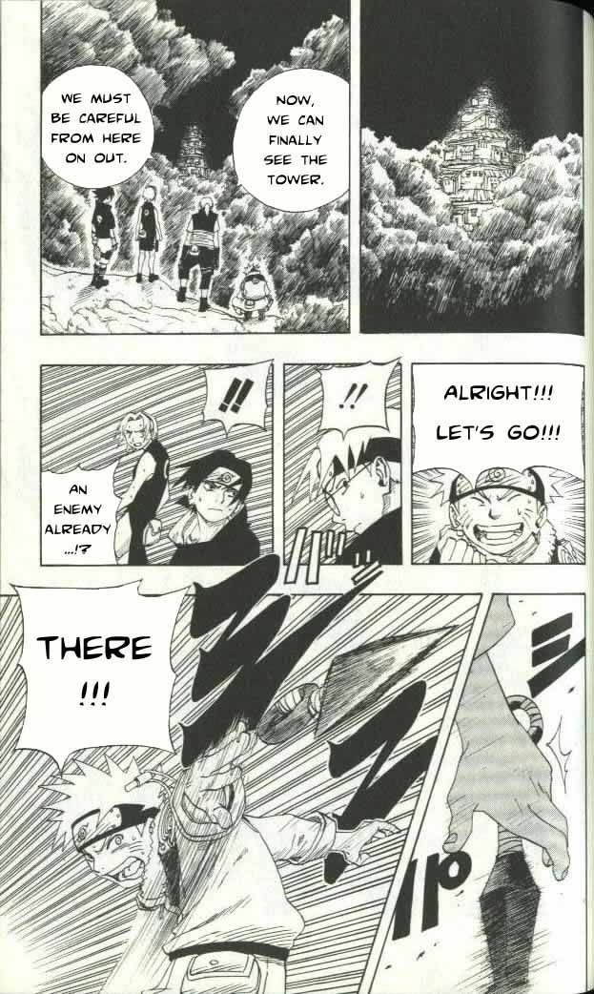
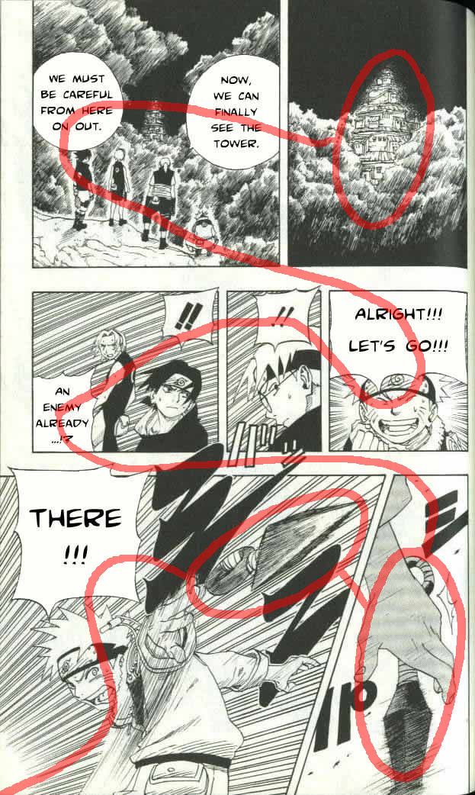
Naruto (Shounen example)
(read from right to left)

Slide 55
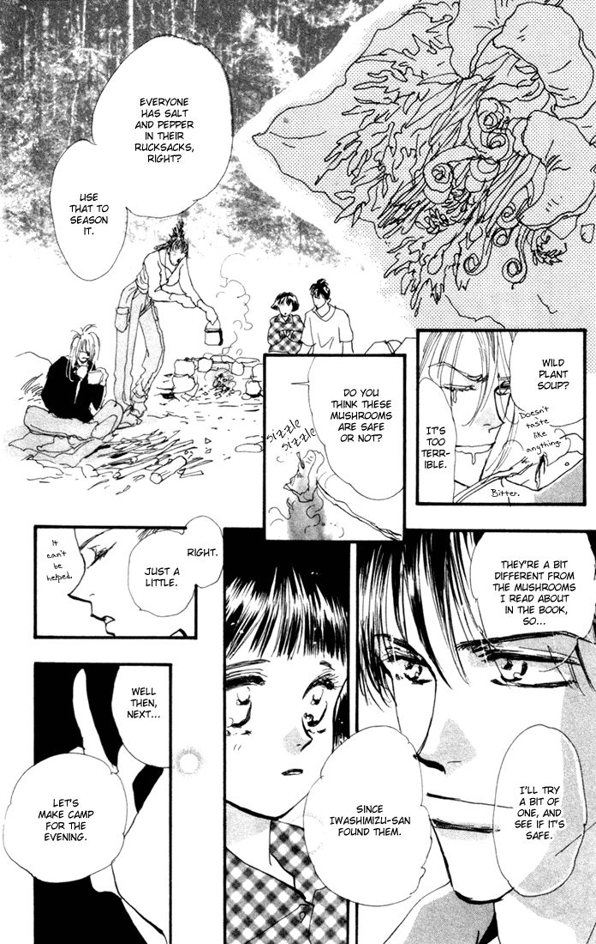
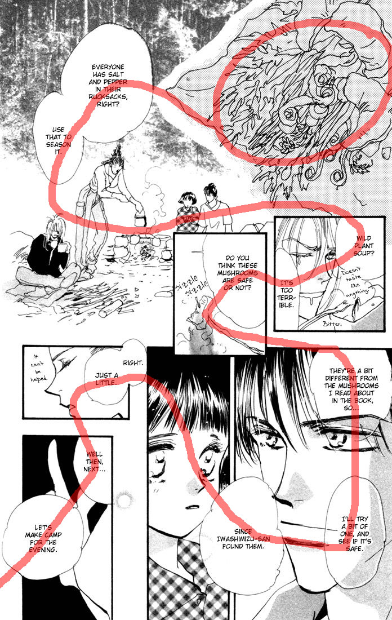
7 Seeds (Shoujo example)
(read from right to left)

Slide 56
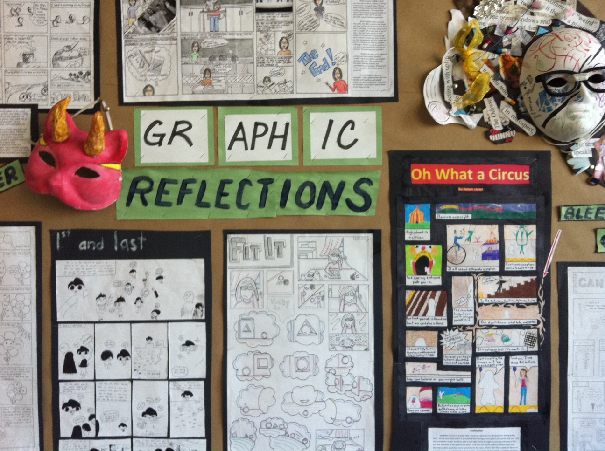

Slide 57


Slide 58
YOUR ASSIGNMENT
Present a page of a graphic novel using your superhero that you have created.
Ensure it is in line with the construction of a Manga/anime adaptation
Things to think about:
Symbolism of objects/colour
Values and attitudes
Audience
Setting

